Slide 1
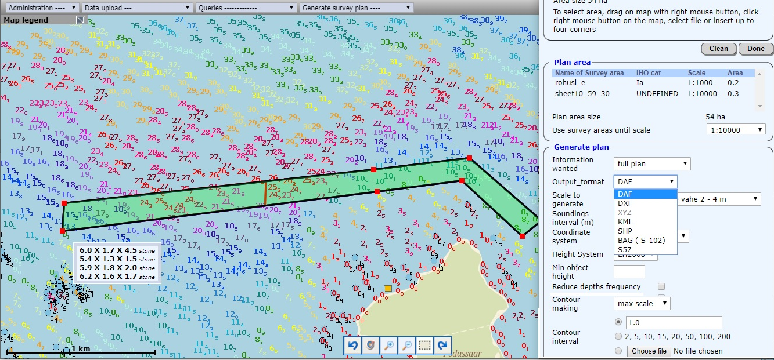

Slide 2
spatial database for hydrographical data manageable in WEB. Data is mainly updated automatically while uploading the survey data;
complex spatial queries over WEB including 3D and bottom profiles to different outputs;
automatic draft generation for Electronic Navigation Charts;
different user profiles: - authenticated users (government) - public users;
OpenGIS Web Map Service (WMS and WFS);
based on open source software (Linux, Postgres, Apache).

Slide 3
Table of content
Topic
slides
Estonian Maritime Administration
3 - 5
Hydrographical Information System HIS
Surveys management
6 - 13
Database and queries
14 - 20
ENC compilation
21 - 26
Administration and technology
27
The presentation is in 30 slides, 20 – main and 10 – accordingly labelled – more detailed
About R-Systems
28 - 30

Slide 4
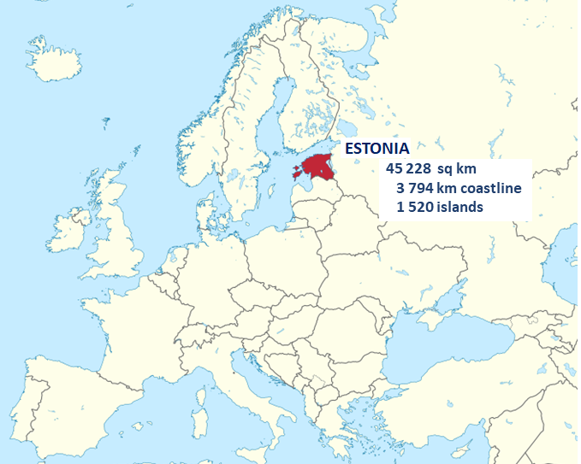

Estonian Maritime Administration
has developed Hydrographic Information System (HIS), which manages hydrographical data in web since 1994 in cooperation with R-Systems Ltd.
By 2016 the HIS was declared to be fully competitive on international market.
www.hydrogis.online (under construction)

Slide 5
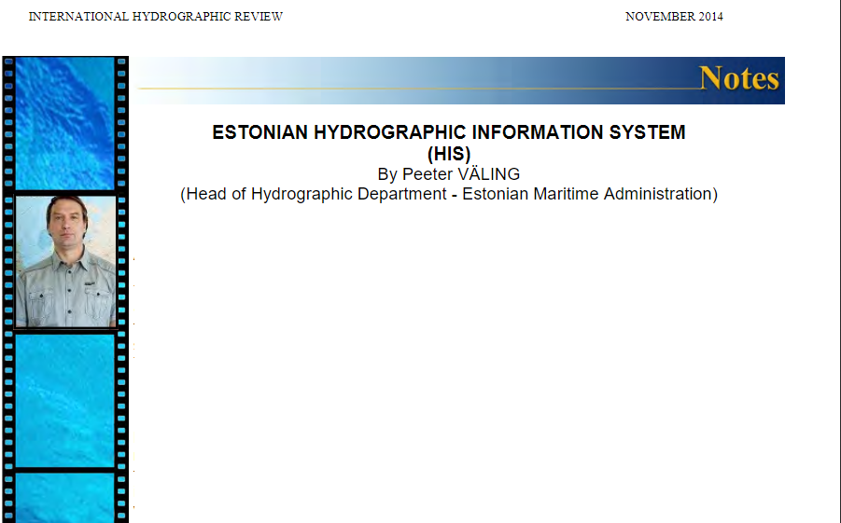
„… The HIS is a very valuable tool for many different tasks starting from surveys management and ending with data viewing/extracting for very different purposes.“
„… Compilation of sea charts is much easier and less time consuming using HIS as there is no need for dealing with individual surveys. HIS creates a basic chart automatically. The cartographers need only to add additional data and do final compilation.“
International Hydrographic review No 12

Slide 6
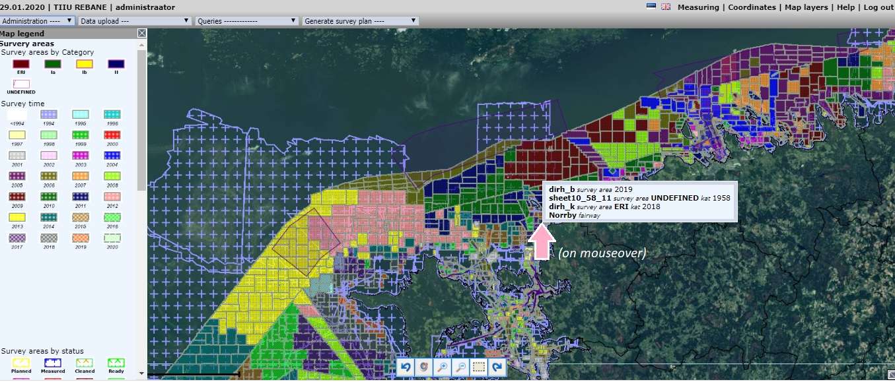
HIS – survey management
Survey areas by survey time.

Slide 7
Survey Area is a folder with data from survey lines, files containing area borders, meta-data, defined underwater objects and all processed depths. All in simple ASCII format. HIS is set to read these files and automatically fill/update database from them.
All survey data together with metadata can be uploaded to HIS and later downloaded for data cleaning or for using in other systems. Metadata can be edited and later exported.
The system tracks the status of survey areas, logs, who changed the data, what operation did he do and when was it carried out. When an area is processed, its status changes and the change is immediately visible to the other users of HIS.
Object data can be further managed in HIS, e.g. object type can be changed from obstruction to wreck, data added from other sources, etc. Survey areas are spatially classified by
IHO44 standard
survey time
survey stage.

Slide 8
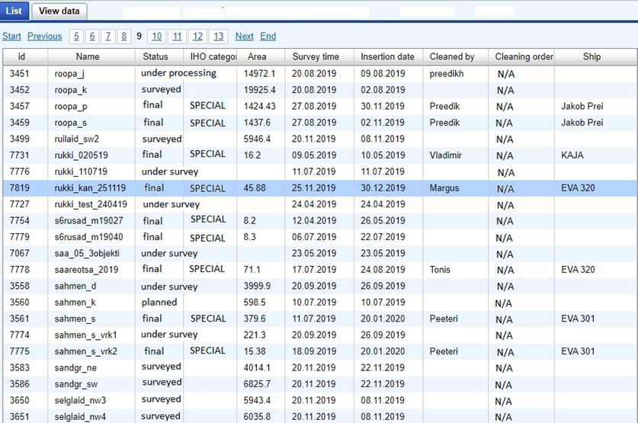
Surveys made in 2019.

Slide 9
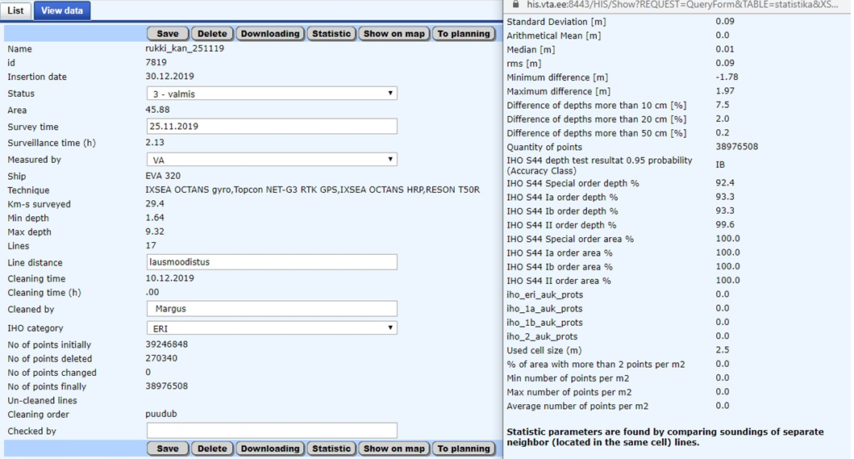
Detailed data and statistics of a chosen Survey.

Slide 10
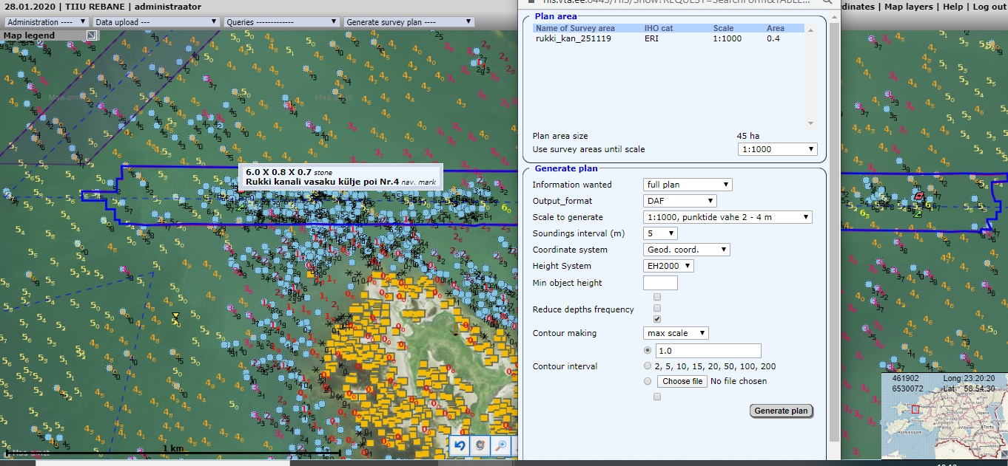
The chosen Survey on the map with orthophoto background, depths and objects layers selected and request to generate a plan from the Survey Area.

Slide 11
HIS – surveys management – detailed 1: work flow
Survey areas are loaded into HIS from packed files. HIS unpacks the file, then extracts information from included ASCII files and fills the relevant tables. The packed file will be automatically copied then into special folder for raw files.
STATUSES are defined by the stage of work-flow. Each stage means updating the tables and overwriting the packed raw data file.
When survey starts on a planned area its status changes to under survey, when survey is finished then the status changes to surveyed.
At the end of each week the survey areas are taken from ships and loaded into HIS.
For post-processing areas with statuses 'surveyed' (the packed raw data file) will be downloaded from HIS and the status changes to under processing.
After the processing the area will be loaded back to HIS and gets status 'processed', the packed raw data file will be overwritten.
Then it will be downloaded for validation and gets status under validation.
Finally after validation the area will be loaded back to HIS and gets status final. The packed raw data file will be overwritten again.
Remark : data files from Estonian survey and post-processing software hold all data – both processed and raw.

Slide 12
HIS – surveys management – detailed 2: automatic procedures
…
Areas with statuses 'final' are used for filling in the depth cells. This process occurs during night.
After loading an area HIS sends an email to relevant persons about the updating.
Loading of areas triggers the following procedures depending on status:
Planned, under survey, surveyed – update or addition of new area into 'info' and 'survey area' table, display update.
Processed – update of the area in tables 'survey area', 'survey_area_hole' (if any holes occur), 'statistics', 'wreck', 'rock', 'sp_survey_area_name' (depths in 1m resolution), display update. For filling the depth table depths are generalized into 1m resolution first. The generalization is also part of HIS software.
Final – the same tables as above + filling the relevant cells with depths and contours, display update. Source for the cell filling are data from depth tables after overlaps analysis. Generalization is used for creating different resolutions of depths and for contour making. Contours are made using GMT (Generic Mapping Tools : triangulate, gridcontour, gmtsimplify). Contours are made first for area 1km wider of the cell to each side and then cut on exact cell border. This ensures that contours from different cells will match. Cutting process takes into account also land areas from table 'landareas'.

Slide 13
HIS – surveys management – detailed 3: comparison
One more important process is comparing new underwater objects (rocks, wrecks, obstructions) to those already in database. This is called conflict resolving.
For wrecks the conflicts are solved using special dialogue in HIS, for other objects automatic procedure takes place. The procedure marks old objects as 'not visible' if they overlap with new ones (in circle with 1m radius) or do not exist in new area. 'Not visible' means that these rocks cannot be accessed through HIS, but they are still kept in table. The aim of that is to allow access only to new and confirmed objects and get rid of duplicates.
Required files: survey areas in packed format (tar.gz). Inside of these :
plan file (contains area border before data processing and planned survey lines)
border file (area border after processing)
statistics file (metadata about survey area)
objects file (defined objects like rocks, wrecks, obstructions)
depths file (all processed depths in XYZ format)

Slide 14
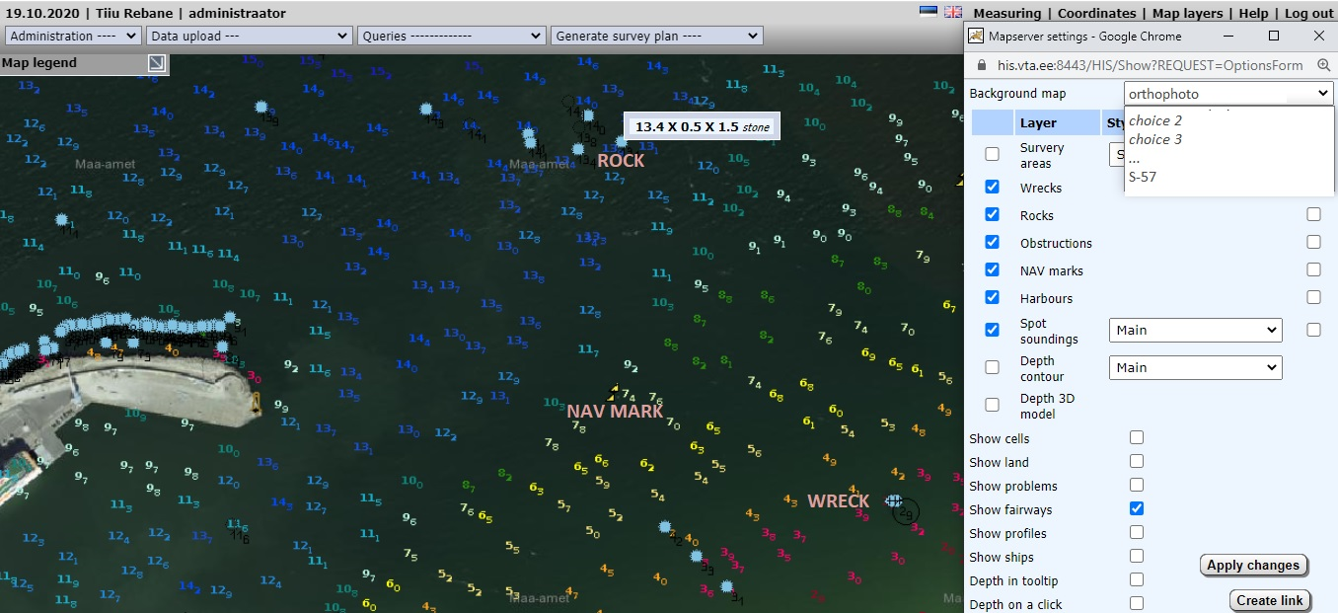
HIS – database and queries

Slide 15
The database consists of two main parts: a seamless database of depths (soundings) and a database of objects. The objects for the system are collected from hydrographic surveys – survey areas, wrecks, rocks and obstructions. For every object extensive information can be stored in HIS, containing its location, classification and attributes, and also images. The navaids and harbours data are taken from other databases.
Queries can be textual, spatial and combined. Textual queries are performed using query builders for any data type in HIS. Spatial queries are performed by keying in coordinates or drawing polygons on a map. Such defined areas act as additional restriction to textual query if so desired. Outputs can be redirected to tables on screen or to different types of files.

Slide 16
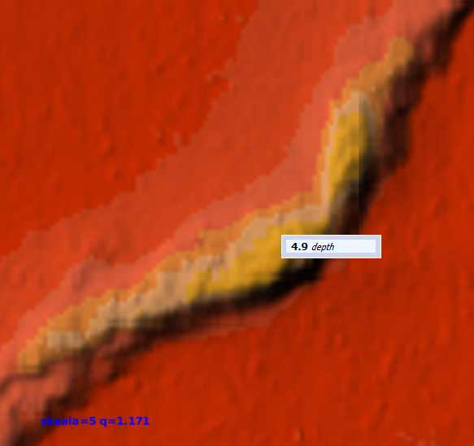
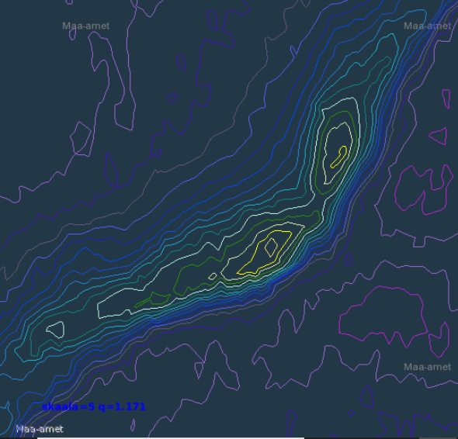
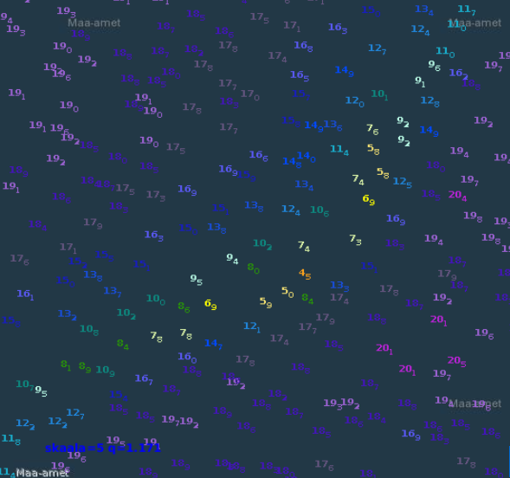
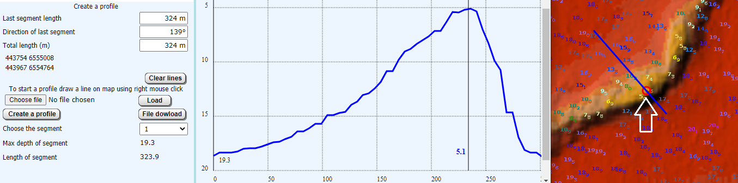

Slide 17
HIS – database and queries – detailed 1
The HIS stores and displays the following data:
Survey areas – borders and meta-data: meta-data includes area status, area size, total survey line lengths, amount of survey lines, survey time, equipment, ship, surveyor, data cleaner, data validator, statistical data (min/max depths and coordinates, amount of points), quality estimators (standard deviation, mean, IHO S-44 order evaluations). Quality estimation is based on overlapping depths from different survey lines.
Depths in up to 1m resolution: Cells store depths in 11 different resolutions from 4m to 200m. On a web map, depths are shown from cells, so starting from 4m resolution. Cells also store depth contours at 1m intervals.
Underwater objects: These include rocks, wrecks and obstructions. Wrecks can have a number of different information ranging from simple dimensions and coordinates through to lengthy records comprising ship’s history and different pictures of the wreck and the ship.
The HIS is also linked to some other databases and this shows information about aids to navigation and harbours. This is useful for getting a complete overview of data in some regions.
The HIS also shows WMS data in the background - currently Estonian land maps, orthophotos and S-57 cells from PRIMAR.

Slide 18
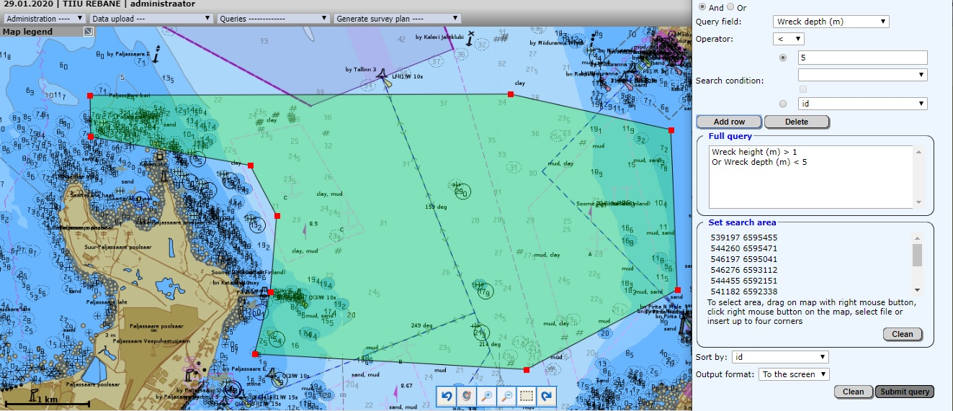
HIS – database and queries – detailed 2
Text query for wrecks higher than 1m or in depth less than 5m in a defined area

Slide 19
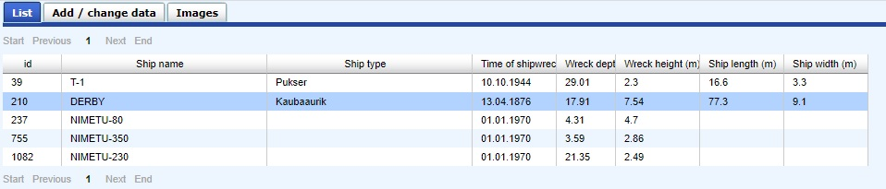
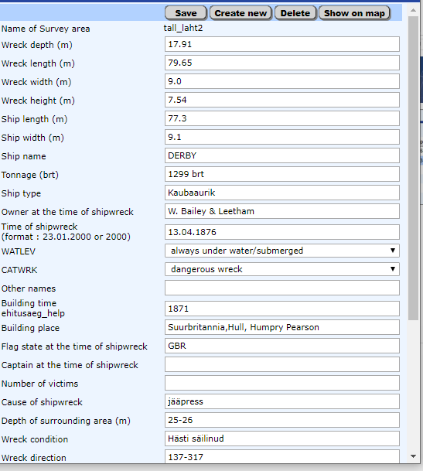
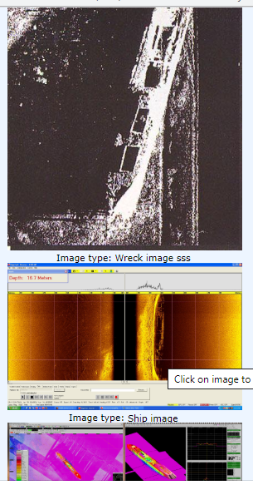
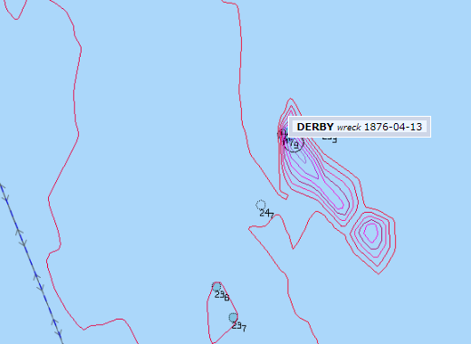
HIS – database and queries – detailed 3
Query results in a list, and for a selected object:
detailed information
images
position on map.
With proper user rights information can be altered right here.

Slide 20
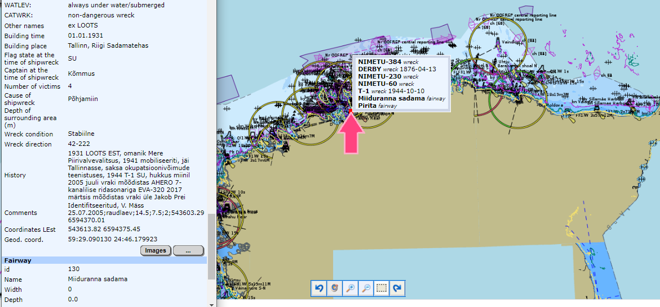
HIS – database and queries – detailed 4
On mouseover all objects under the cursor are listed. Click will result in next list of detail data of objects.

Slide 21
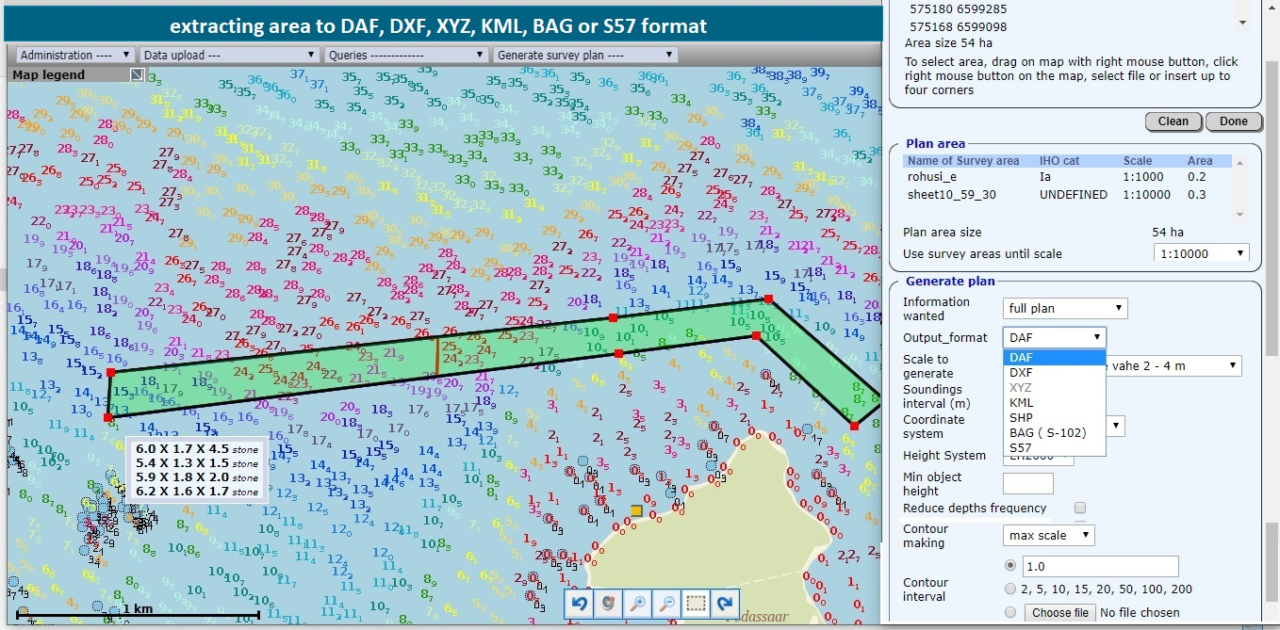
HIS – ENC compilation

Slide 22
To obtain data for ENC first defining the required area (by coordinates or interactively from map), scale and contour intervals are necessary. The HIS then finds survey areas inside the defined area, analyses overlaps, extracts depths, objects and contours, performs sounding generalization into the desired scale, creates necessary meta-objects from survey areas and saves all data into required format (DAF by default). DXF and ESRI Shape formats are available but they do not represent S-57 objects, and also do not include meta- objects. Depths and contour output depends on the desired scale or output resolution. Starting from a scale of 1:5000 or depth resolution of 4m, the data are taken from cells instead of depth tables of survey areas. This significantly decreases depth extraction time as data in cells are already prepared into the desired scale. It also makes possible depth extraction from very large areas, for example from all Estonia (total area of larger water bodies is around 36,000 km 2 ).

Slide 23
Overlaps.
In order to query depths or objects from overlapped survey areas some automatic procedures have to be performed. First topological analysis of area borders gives exact areas where overlapping occurs, second procedure analysis relevant survey areas and finds which ones have better quality and/or newer data. These data will have precedence over others, so querying depths from HIS gives from overlapping survey areas only newest and better quality data.
Cells.
For seamless depth and contours database HIS is using cells. Depths are stored in cells in 11 different resolution from 4 to 500 m. Contours are created and stored in 1m interval. Viewing and querying the depth data means getting data from relevant cells in resolution needed. That makes possible to see data in web mapping services quickly. Same is true about depth contours. The cells are filled automatically from survey areas when new validated data are available.

Slide 24
HIS – ENC compilation – detailed 1
Definitions :
1) Defining area of interest (the same way as spatial query)
2) Defining required information type : only depths, only objects or full data (depths,objects,contours)
3) Defining wanted output format : available formats are S-57, DAF (Dkart ASCII format), DXF, Shape, XYZ, KML. Output format depends on previous selection – for example only depths are allowed only into XYZ format.
4) Defining output scale or depth resolution (if only depths selected) from predefined list.
5) Defining contour interval : 3 possible ways – one interval, predefined 'cartographic' intervals or intervals from text file.
6) Defining output coordinate system : currently EPSG:3301 and EPSG:4326 (WGS84 lat/long). Other possibilities are available.

Slide 25
HIS – ENC compilation – detailed 2
Processing :
1) After definitions the process first analyses defined area – if the area is less than 50 km2 then the depth data will be taken from depth tables for each survey area and contours will be created based on these depths . Generalization of depths will be done according to defined scale/depth resolution. If bigger than 50 km2 then depths and contours are taken from cells. As depths in cells are already stored in different resolutions then no further generalization is needed – depths are selected in defined resolution. If area is bigger than 8000 km2 then only allowed information type is only depths .
Such approach makes data access very quick – compiling basic map in S-57 format in scale 1:100000 from 6000 km2 area from hundreds different survey areas takes just some minutes.
The area sizes are definable in configuration file.

Slide 26
HIS – ENC compilation – detailed 3
2) First case also triggers analyses of overlaps: depths are taken from overlapping survey areas taking into account survey time and quality (IHO_S44 class). Second case does not need such analysis as the cells are already filled in this way.
S-57 and DAF formats will need analysis of overlapping survey areas anyway as the required meta-objects (like MQUAL) need this.
c. Next process selects depths from tables or cells according to defined area and generalizes them into output scale if needed.
3) Then contours will be generated or selected if it was wanted.
4) Selection of underwater objects if wanted.
5) Finally all these data will be written into selected output data format and download link will be sent to user.
The whole process is logged, temporary files and log files are stored in special folder. This folder is cleaned once a week.
Brief log about user activities is also kept in database (tables 'stat user', 'stat user info', 'stat user plan')

Slide 27
HIS – Administration and technology
Application
is written in Java.
Frontend is HTML generated by XSL conversion and JavaScript.
The system can be administered remotely.
The main activities are logged both for system and each user separately.
Any change in main database is automatically reflected in backup database. In addition, raw data and system are backed up daily.
Base software
Fedora core 64-bit Linux
PostgreSQL and PostGIS
F-Open mapserver (serves WMS/WFS)
Apache Tomcat
GMT
JTS (Jump Topological Suite)
In Estonia the main server requires 5 TB of disk space and 70 GB RAM with two CPU-s.

Slide 28
R-Systems Ltd. (R-Süsteemid OÜ)
is an Estonian Hi-Tech software development company with spatial data processing expertise dating back to 1989.
since 1991 – software development for air surveillance systems
since 1994 – hydrographic survey and data management systems
since 1994 – development of the basic means for geo- information systems
since 2000 – web-based systems
since 2002 – minehunting operations and information system
since 2002 – browser-based geo-information systems (WEB GIS)
since 2006 – modernisation of naval navigation systems
since 2010 – tactical data links
since 2012 – land planning since 2013 – isobath technology for hydrographical data presentation since 2017 – AI for hydrographical survey data processing since 2020 – 3D and bottom profile for hydrographical data presentationinformation
R-Süsteemid OÜ
www.r-systems.ee info@r-systems.ee
Tallinn, Estonia

Slide 29
R-Systems develops for EMA also
Survey Software
to to collect, store, analyse and present bathymetric data
Planning of survey jobs (graphical editing of the survey plan).
Reading data from sonar, GPS-receiver, (gyro) compass and motion sensor.
Presenting the collected data recalculated into soundings both on the background of the chart and as a three-dimensional bottom relief.
Storing collected data.
Presenting the information necessary for navigation to the helmsman on a separate screen.
Checking the sounding coverage of the survey area.
Water column and snippet data
Autopilot mode
Different modes for sounding visualization

Slide 30
Post-processing Software
to check and filter out erroneous bathymetric data.
Searching and removing the occasional errors in the collected data.
Interactive editors and automatic filters.
Visualising and analysing the bottom profile.
Special echo selecting techniques for multiecho sonars, large volume handling (hundreds of millions soundings)
Searching and marking the discovered underwater objects on the chart.
Analysing the quality of survey- both the area coverage and accuracy of measurement.
Exporting checked soundings to cartographic GIS or other analysing systems.
3D modelling of the sea floor.
Smile (specific error in data caused by wrong sound velocity) optimization.
AI (Artificial Intelligence) for detecting survey errors (pikes) and objects (currently under development).

